Slide 1
DSPG 2019
Projects

Slide 2
Project​ | a.k.a​ | Sponsor/Contact(s)​ | Lead​ | SDAD Team​ | Size
01. Credential-to-Skilled Technical Workforce (STW) Pathways in Virginia​ | Skilled Technical Workforce (STW)​ | John Finamore, National Center for Science and Engineering Statistics (NCSES)​ | Vicki​ | ​ | 1 fellow ​ 2 interns​
02. Machine Learning Techniques to Measure Business Innovation ​ | Business Innovation​ | Gary Anderson, NCSES​ | Devika​ | Gizem​ Neil | 1 fellow ​ 1 intern​
03. Defining and Measuring the Universe of Open Source Software​ Innovation​ | OSS​ | Carol Robbins, NCSES​ | Gizem​ | Bayoán​ | 1 fellow ​ 2 interns​
04. Measuring the Public Funding of R&D Projects​ | R&D Metrics​ | John Jankowski, NCSES​ | Stephanie​ | ​ | 1 fellow ​ 1 intern​
05. Discovering the Potential and Use of New Data Sources to Measure the Soldier’s Social Determinants of Health​ | ARI​ | Army Research Institute (ARI)​ | Stephanie​ | Josh​ | 1 fellow ​ 2 interns​
06. Validation of Broadband Data and Identification of Factors that Predict Property Values ​ | USDA Broadband​ | John Pender, USDA Economic Research Service (ERS)​ | Josh​ | Teja​ Stephanie​ | 1 fellow ​ 2 interns​
07. Economic and Social Impact of Arlington Restaurant Initiative​ | ACPD​ | Jim Mastoras​ Arlington County Police Department (ACPD)​ | Bayoán​ | Gizem​ Aaron​ | 1 fellow ​ 1 intern​
08. Building a Fairfax County CommunityScape to Understand Social Determinants of Health and Prosperity​ | Fairfax & INOVA​ | Fairfax County Health and Human Services,​ & Inova Translational Medicine Institute​ ​ | Teja​ | Joy​ Stephanie​ Vicki​ Josh​ Nathaniel​ Devika​ | 2 fellows​ 2 interns​
09. Returning Citizens Reentry Program​ ​ | Criminal Justice​ | Gregory Fairchild, Darden; UVA​ & Virginia Department of Corrections (VADOC)​ | Nathaniel​ | Joel​ Bayoán​ Gizem​ Aaron​ | 1 fellow 1 intern​

Slide 3
01-Credential-to-Skilled Technical Workforce (STW) Pathways in Virginia
To be considered a skilled technical occupation two criteria must be met:
1. a high level of knowledge in a technical domain; and
2. a bachelor's degree for entry is not required. (Rothwell, 2015)
Why are these occupations important:
they provide a pathway for individuals to enter the middle class without the expense of a college degree; and
to remain competitive in the global economy, foster greater innovation, and provide a foundation for shared prosperity, the US needs a workforce with the right mix of skills to meet the diverse needs of the economy.

Slide 4
How do we construct "mismatch" metrics between these three components for the metropolitan statistical areas (10) in Virginia that can be used inform policy?
Who & where are the EDUCATORS; what SKILLS do they teach?
Who & where are the JOB SEEKERS; what SKILLS do they have?
Who & where are the EMPLOYERS; what SKILLS
do they demand?

Slide 5

Machine Learning Techniques to Measure Business Innovation
SDAD Team: Devika Nair & Gizem Korkmaz & Neil Alexander
Sponsor: Gary Anderson, National Science Foundation (NSF) National Center for Science and Engineering Statistics (NCSES)

Slide 6
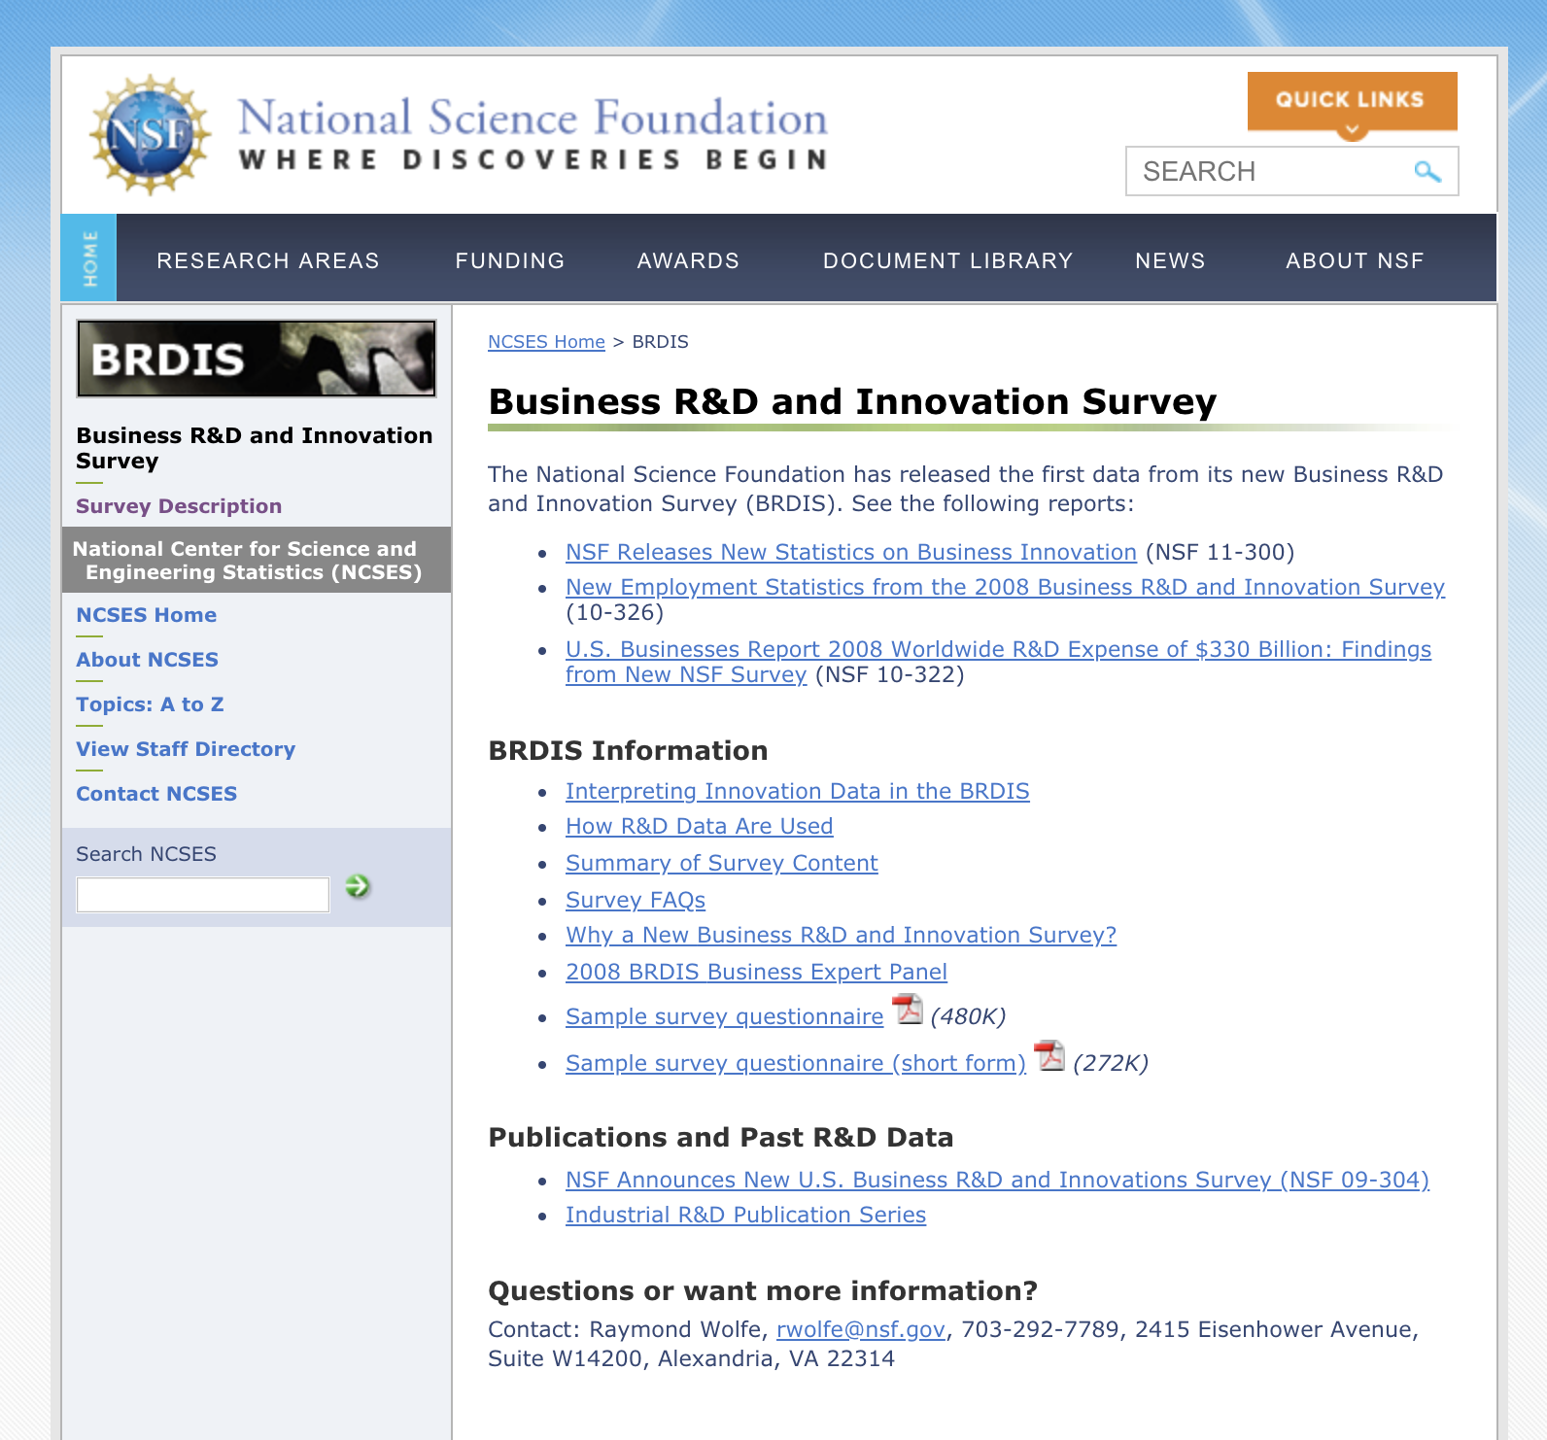
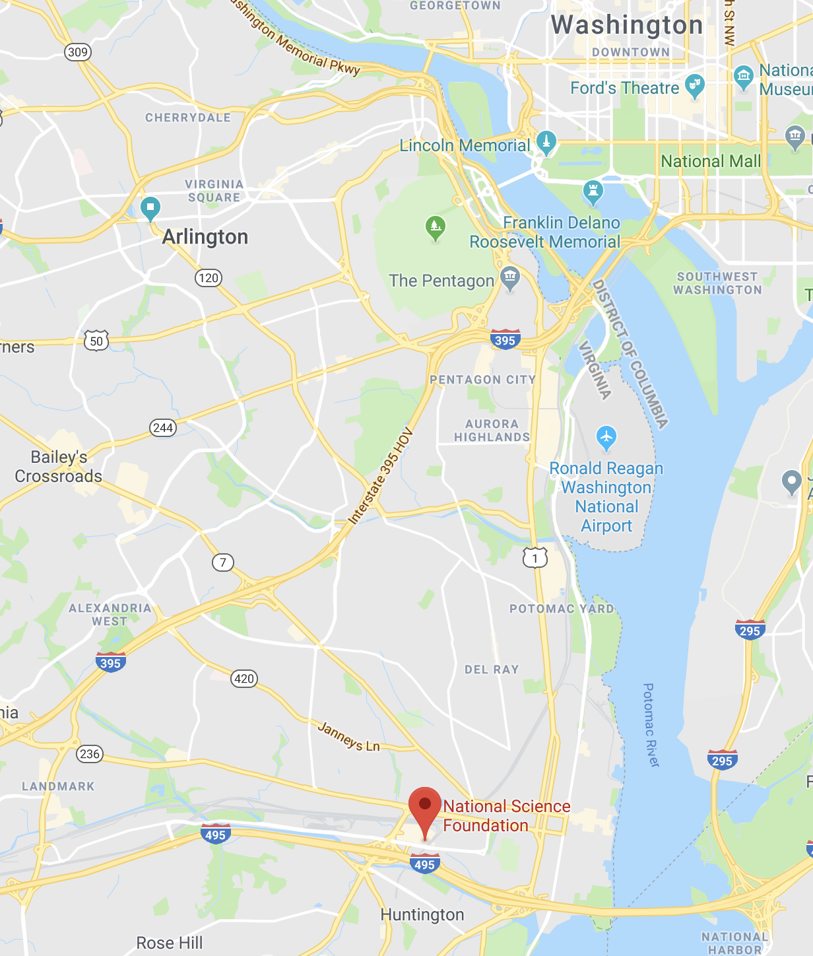
Notes:
Mac - Homebrew
Windows - nothing

Slide 7
Research Questions
How can the BRDIS survey data on innovation be supplemented by alternative sources of data?
Can we duplicate or extend the findings of the BRDIS survey using alternative sources of data?
Can we use machine learning mechanisms to predict innovation: when it happens, who performs it, what products result from it, and what kind of innovation is it?
Notes:
Mac - Homebrew
Windows - nothing

Slide 8
Pharmaceutical Focus
Company's Internal R&D
FDA Application & Approval
Media & News Outlet Reports
Market Activity
Financial Reports
New product pipeline for pharmaceutical industry: new drugs and new devices
Current data assets
FDA Database
Dow Jones Factiva/DNA
?
SEC 10-K Filings
Proquest
Proquest
Notes:
Mac - Homebrew
Windows - nothing

Slide 9
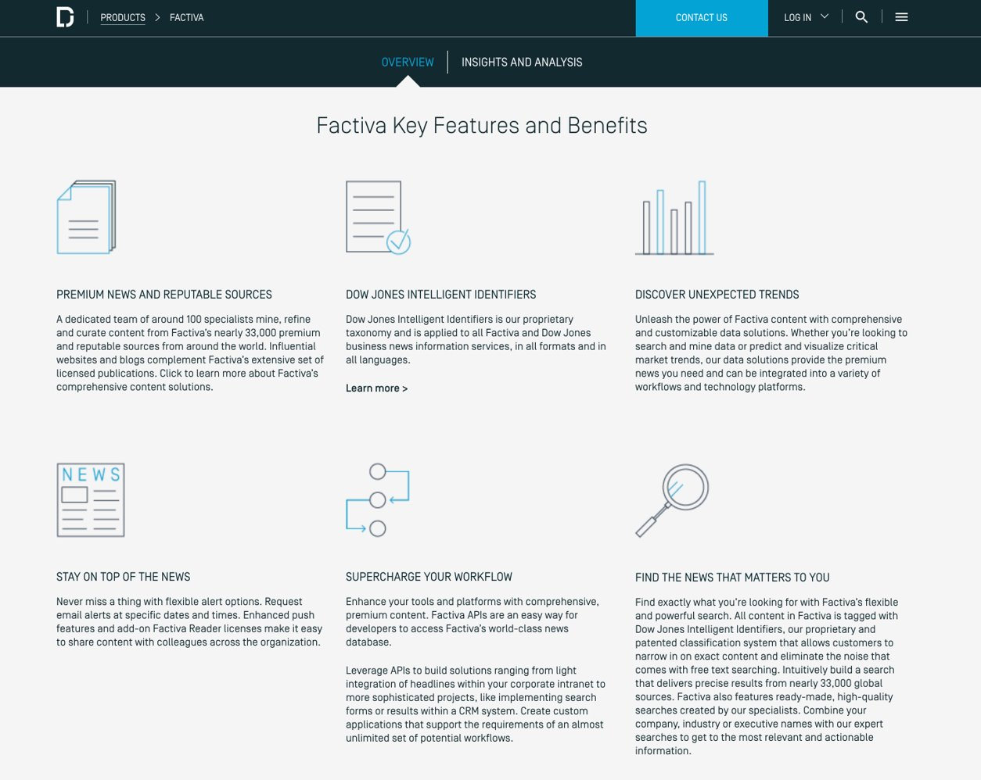
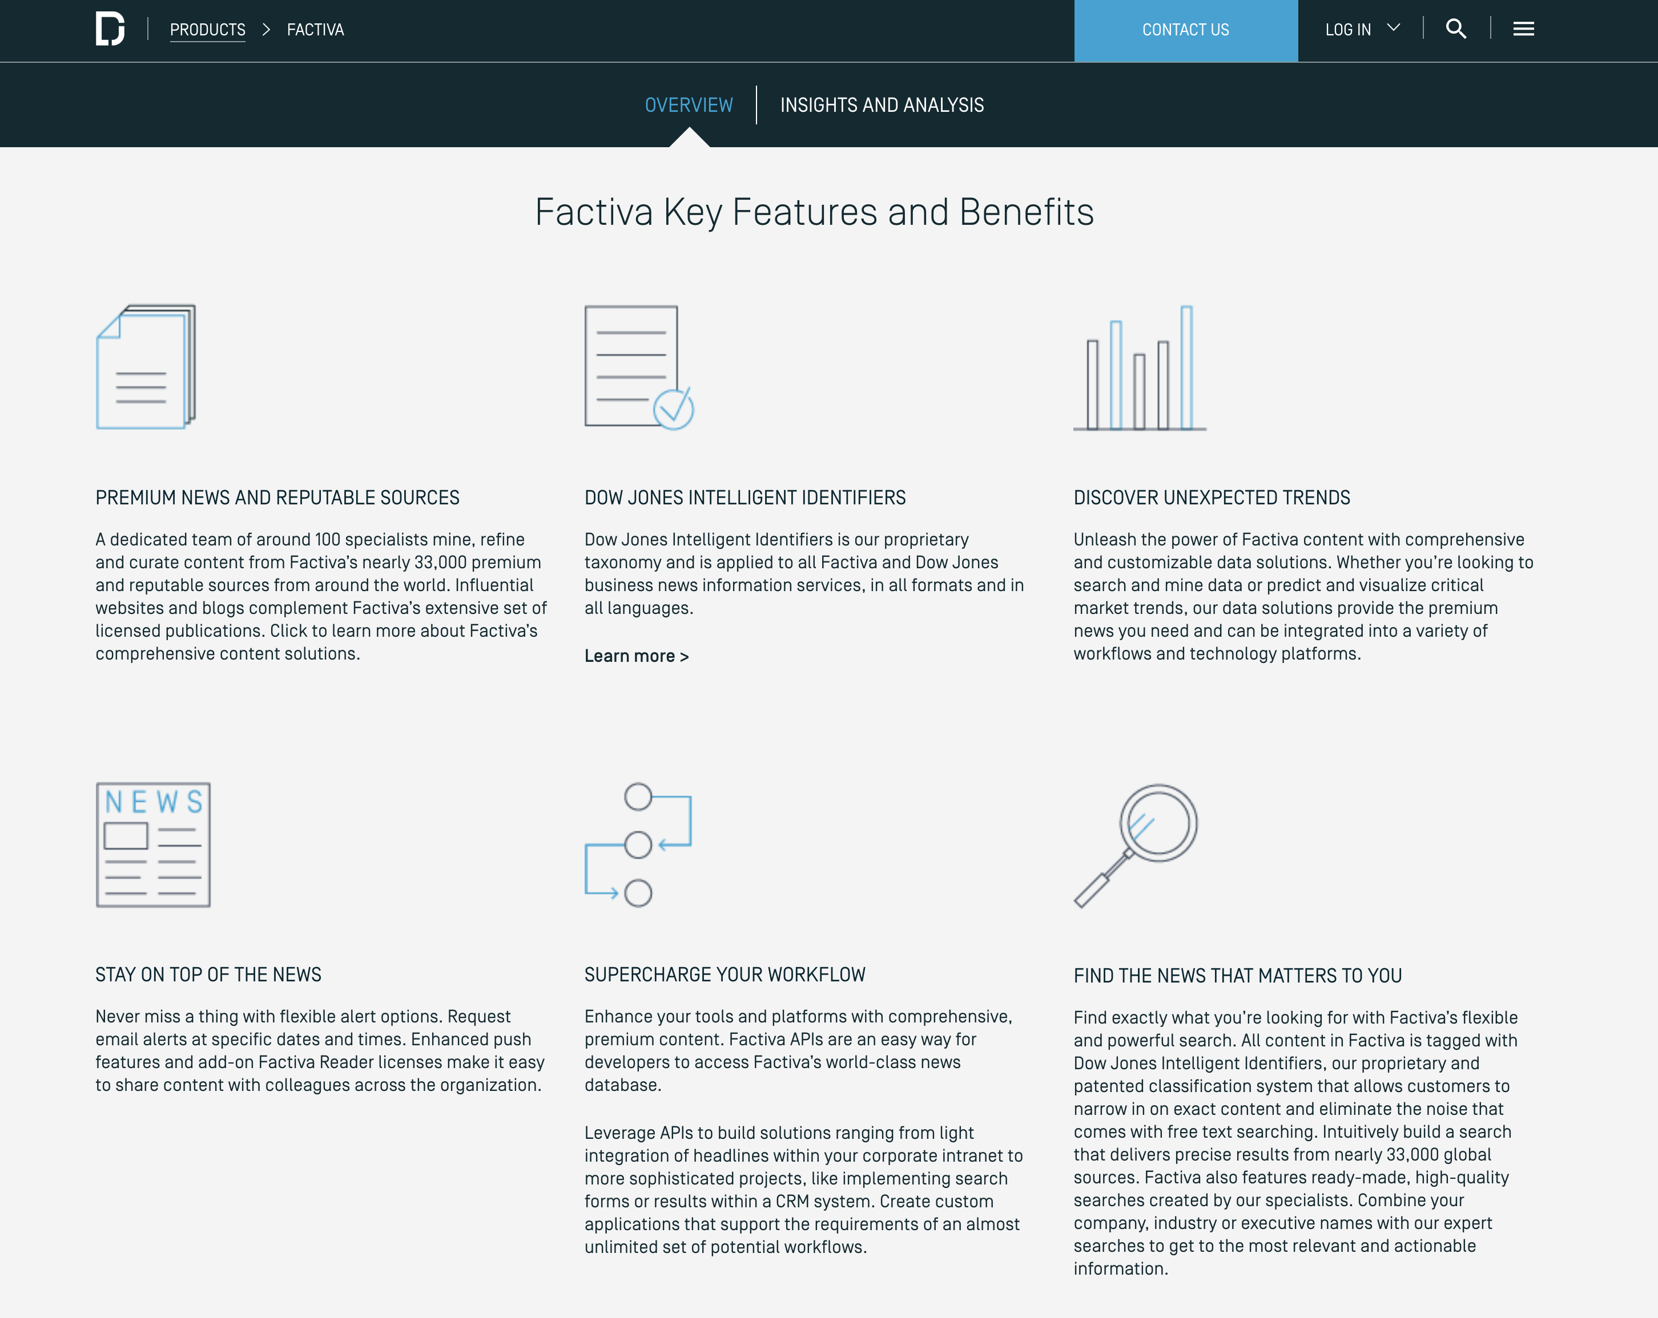
Dow Jones Factiva
“
Power your decision making with Factiva’s global news database of nearly 33,000 premium sources, including licensed publications, influential websites, blogs, images and videos. 74% of Factiva’s premium news sources are not available on the free web and thousands more are available via Factiva on or before the date of publication by the source. Whether you’re looking for a global point of view or need to dive deep into a particular region with local coverage, get the essential information you need from Factiva’s trusted, quality sources.
”
https://www.dowjones.com/products/factiva/
Notes:
Mac - Homebrew
Windows - nothing

Slide 10
Project Activities
Machine Learning Model
Data Discovery
Text Analysis
Data Discovery
FDA Database
Dow Jones Factiva/DNA
Market Activity
SEC 10-K Filings
Notes:
Mac - Homebrew
Windows - nothing

Slide 11

Deliverables
Technical Products
Text-based method for identifying and characterizing innovation
Final datasets
Machine Learning Output (model, networks)
Visualizations
Presentation Products
Literature Review
DSPG Symposium Poster
SAGE publication draft for submission
Notes:
Mac - Homebrew
Windows - nothing

Slide 12
Defining and Measuring the Universe of Open Source Software (OSS) Innovation
SDAD Team: Gizem Korkmaz & Bayoán Santiago Calderon
Sponsor: Carol Robbins, National Science Foundation (NSF) National Center for Science and Engineering Statistics (NCSES)

Slide 13

Project Overview
Open Source Software (OSS) is a computer software with its source code made available with a license in which the copyright holder provides the rights to study, change, and distribute the software to anyone and for any purpose [Open Source Initiative, 1998].
• within and outside of the private sector • universities (e.g., Stanford, MIT, UC-Berkeley), businesses (e.g., Microsoft, Google), government research institutions (e.g., Sandia National Lab), nonprofits, and individuals
Current NCSES and other economic indicators do not measure the value of open source software outside the business sector
Importance of quantifying coding impact in the scientific community
Citations are used to measure the impact of patents and publications which are most frequently used to estimate the research outputs of universities and government institutions.
The goal is to test the feasibility and to develop methods to measure the impact and scope of open source software
DSPG Summer 2019

Slide 14
Research Questions
How much open source software is in use? (stock measure)
How much is created each year? (flow measure)
What types can be identified?
Who creates it? (Sectors: Business, Government, Academia, Households, Nonprofits, Foreign)
What sources of data and variables could serve as proxies for measuring attributes and economic value of open source software?
Counts of OSS, by sector (e.g., university, government), by technology
Attributes, e.g., # citations, #downloaded, languages, etc.
DSPG Summer 2019

Slide 15
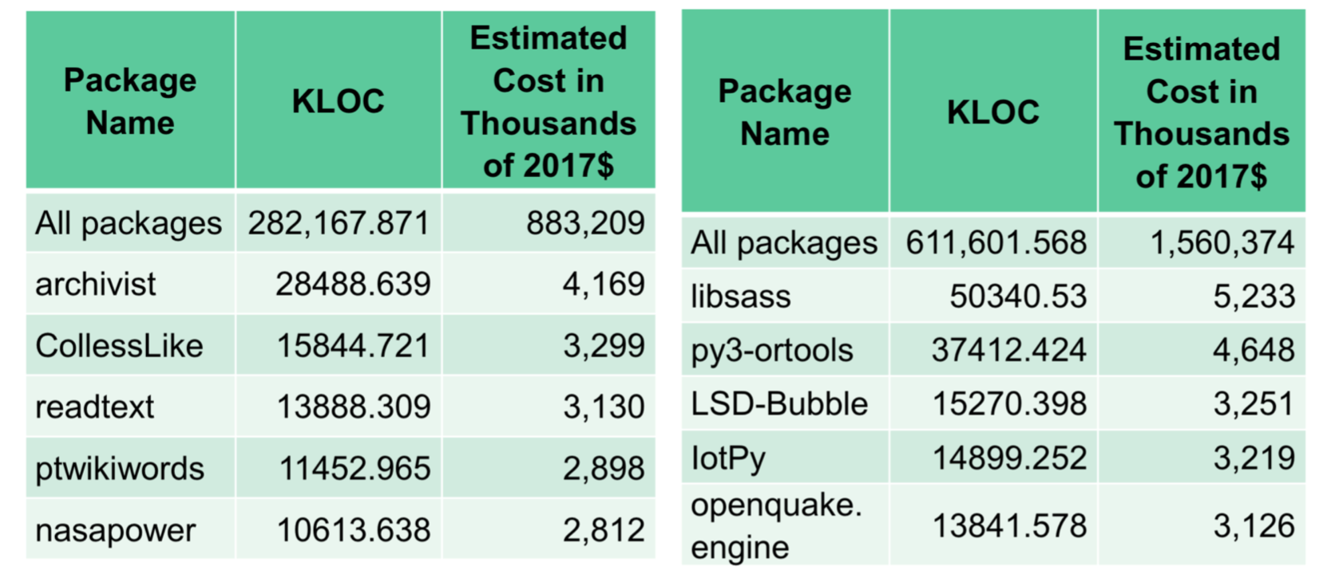
Prior Work
• Cost of Software Package Creation
Identify number of people involved each package’s development;
Estimate time spent on software development;
Use average compensation for computer programmers;
Estimate intermediate inputs based on BEA (Bureau Economic Analysis) and OECD (Organisation for Economic Co-operation and Development) methodologies.
Cost of R and Python Packages developed on GitHub
DSPG Summer 2019

Slide 16
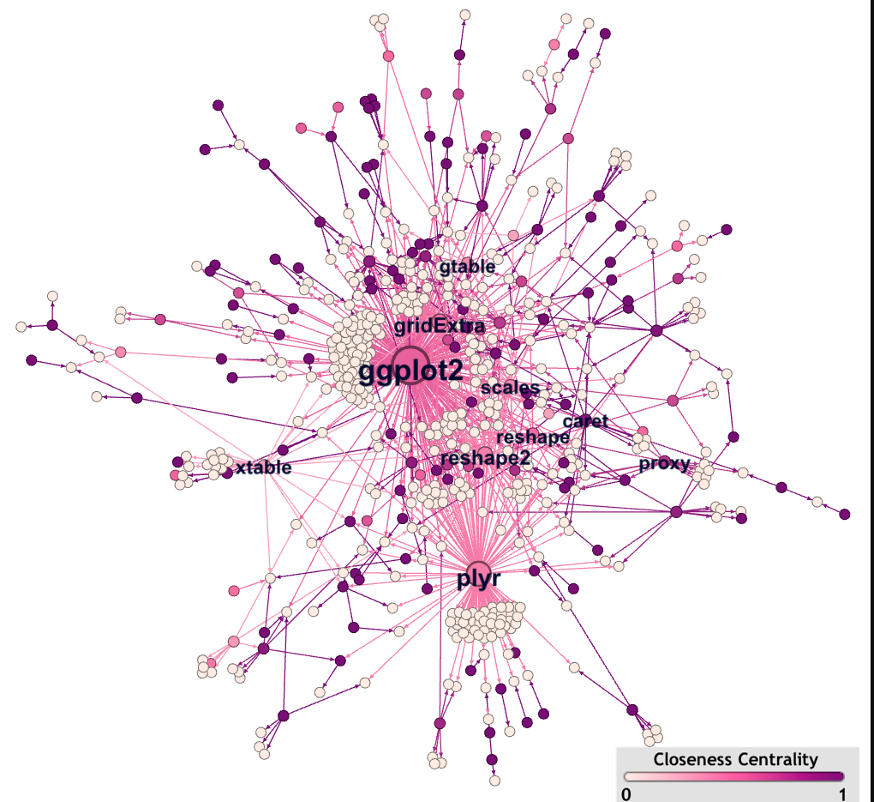
Summer Project Goals & Deliverables
What is the Universe of OSS?
Discovering and collecting information on software projects that have a copyright and/or a trademark in the US.
Data Sources:
USPTO trademark and patent data
Library of Congress Copyright data (scraping)
Data Analysis: contributions by sector (business, university, government, household), and by geography.
Using ORCID database to find information on developers of R packages that are registered on CRAN.
DSPG Summer 2019
Analyze interactions between contributors and the diffusion of OSS innovation across institutions and sectors using dependency and contributor networks.

Slide 17



04-Measuring the Public Funding of R&D
Team
Sponsor – John Jankowski, NSF NCSES Director for R&D Statistics SDAD - Stephanie Shipp, economist​, Joel Thurston, social psychologist​
Notes:
NCSES (spell out) is the statistical agency for NSF. It is one of the top 13 statistical agencies among over 100 statistical agencies across the government. They work with OECD to make consistent comparisons of R&D measures across countries.
In the United States, the federal government is a major source of R&D funding for universities, nonprofit organizations, federal institutions, and federally funded research and development centers (FFRDCs). The federal government funds a substantial amount of all basic (accounting for 44% of funding in 2015) and applied research (accounting for about 36% of funding in 2015). During the post-recession period from 2010 through 2015, however, the share of U.S. R&D funded by the federal government declined, from just over 30% to around one-fourth, primarily reflecting the waning after 2010 of the incremental funding from the American Recovery and Reinvestment Act (ARRA) and the uncertain federal budget environment since 2011, including broad federal spending caps. Business R&D has led the overall growth in U.S. R&D during this period. The decline in federal funding is an important trend that we will continue to follow, given the federal government’s critical role in the overall R&D infrastructure in the United States.

Slide 18
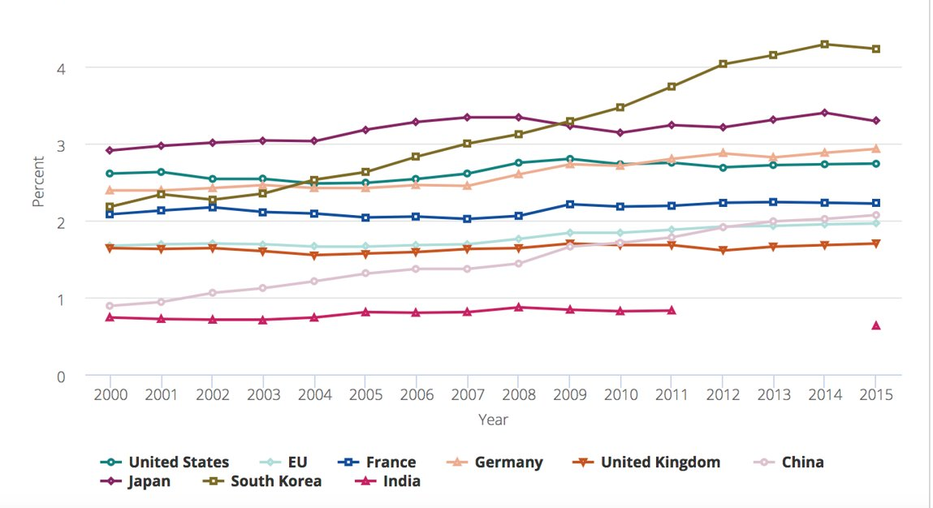
Why Care?
R&D Intensity by Selected Region, Country, or Region, 2000-2015
Notes:
As a share of Gross Domestic Product or GDP, R&D funding is overall high in Japan – the purple, but has been surpassed by Korea. The US (green) hovers in 3rd and 4th place. A goal that many countries set is to allocate 3% of GDP to R&D, but rarely achieve.
In the United States, the federal government is a major source of R&D funding for universities, nonprofit organizations, federal institutions, and federally funded research and development centers (FFRDCs). The federal government funds a substantial amount of all basic (accounting for 44% of funding in 2015) and applied research (accounting for about 36% of funding in 2015). During the post-recession period from 2010 through 2015, however, the share of U.S. R&D funded by the federal government declined, from just over 30% to around one-fourth, primarily reflecting the waning after 2010 of the incremental funding from the American Recovery and Reinvestment Act (ARRA) and the uncertain federal budget environment since 2011, including broad federal spending caps. Business R&D has led the overall growth in U.S. R&D during this period. The decline in federal funding is an important trend that we will continue to follow, given the federal government’s critical role in the overall R&D infrastructure in the United States.

Slide 19
Background & Research Question
NSF NCSES collaborates with the Organization for Economic Cooperative and Development (OECD) Working Party of National Experts on Science Technology and Innovation (NESTI)
NESTI is interested in a proof of concept for an international micro database on public funding of R&D projects drawing on the increasing openness and availability of administrative microdata
Research Question – can data about publicly funded R&D be collected using existing data versus survey collection? How does it compare to currently collected data? Does it open up the black box for measuring R&D?
Notes:
NCSES (spell out) is the statistical agency for NSF. It is one of the top 13 statistical agencies among over 100 statistical agencies across the government.
They measure R&D and innovation though surveys. They are working with OECD to assess the feasibility of collecting the data through existing administrative data sources. NCSES has asked us to assess the feasibility of doing this.
Research Question – can data about publicly funded R&D be collected using existing data versus survey collection? How does it compare to currently collected data? Does it open up the black box for measuring R&D?

Slide 20
Is Capturing Public Funding from Existing Data Sources at 6 Science Agencies Feasible?
Using the SDAD Data Science Framework as a guide, the research will focus on
discovering, inventorying, screening, and documenting availability of publicly available R&D expenditure data sources from 6 federal science agencies
acquiring data available on the web or directly from agency,
comparing the data to published estimates, accounting for different time periods
presenting the data in new and useful ways, i.e., can the data be linked to show cross-agency funding by discipline or scientific area, e.g. by nanotechnology, as well as who is funding research? Can the data be linked to publications to show impact and networks?
T
DSPG Summer 2019
https://www.nsf.gov/statistics/natlpatterns/

Slide 21

05-Discovering the Potential and Use of New Data Sources to Measure the Soldier’s Social Determinants of Health
U.S. Army Research Institute for the Behavioral and Social Sciences
Team: Sponsor – Kelly S. Ervin, Ph.D., Senior Research Psychologist, U.S.ARI
SDAD -Stephanie Shipp, economist​, Josh Goldstein, statistician​, Nat Ratcliff, social psychologist, Joel Thurston, social psychologist​, Vicki Lancaster, statistician​

Slide 22
U.S. Army Research Institute for the Behavioral and Social Sciences
Army’s lead agency for the conduct of research, development, and analyses for the improvement of Army readiness and performance
Uses research advances and applications of the behavioral and social sciences that address personnel, organization, training, and leader development
ARI's research contributes to recruiting, selection, assignment, training, mission performance, and situational awareness of the Soldier

Slide 23
Research Question
Are these civilian data sources useful for our Army research to understand Soldier social determinants of health with a focus on the effects of community embeddedness on Soldier behavior and performance?

Slide 24

The Department of Defense Education Activity (DoDEA)
•civilian agency of the United States Department of Defense that manages schools for military-connected children in the United States and overseas at American military bases
•DoDEA's schools serve the children of military service members and Department of Defense civilian employees throughout the world. Children of enlisted military personnel represent 85 percent of the total enrollment in DoDEA schools.
•DoDEA also provides support to more than one million military-connected students who attend public schools throughout the United States
Notes:
We are currently used dozens of sources of data – most from the DOD and the Army and a civilian data set, the ACS.
The team will first undertake a data discovery exercise to discover new civilian sources of data and assess their feasibility for use.
However, there are two data sources that we are very interested in and would like to explore further.

Slide 25

The Behavioral Risk Factor Surveillance System (BRFSS)
System of health-related telephone surveys that collect state data about U.S. residents regarding their health-related risk behaviors, chronic health conditions, and use of preventive services.
Established in 1984 with 15 states, BRFSS now collects data in all 50 states as well as the District of Columbia and three U.S. territories. Initial focus on Virginia.
BRFSS completes more than 400,000 adult interviews each year, making it the largest continuously conducted health survey system in the world.
Also a Youth Survey Component and more ...
Notes:
The BRFSS, also known as the Virginia Adult Health Survey (VAHS), is a telephone survey conducted by the health departments of all states, the District of Columbia, Puerto Rico, the U.S. Virgin Islands and Guam with assistance from CDC. The BRFSS is the largest continuously conducted telephone health surveillance system in the world.
States use BRFSS data to:
Identify emerging health problems
Establish health objectives and track their progress
Develop and evaluate public health policies and programs to address identified problems
The BRFSS is the primary source of information for states and the nation on the health-related behaviors of adults. States collect data through monthly interviews with adults aged 18 years or older. BRFSS interviewers ask questions related to behaviors that are associated with preventable chronic diseases, injuries and infectious diseases.

Slide 26
Measuring Soldiers' Social Determinants of Health & Effect on Community Embeddedness
Using the SDAD Data Science Framework as a guide, the research will focus on:
discovering, inventorying, screening, profiling and documenting the data sources, including accessibility, resulting in a technical report (using common outline using common outline);
acquiring data available on the web (Virginia for BRFSS and all schools and areas for DoDEA );
conduct exploratory data analysis;
reviewing the literature for examples of uses of these data sources and developing and constructing community embeddedness composite indicator(s).

Slide 27
USDA ERS Broadband
Data Science for Public Good Project
Josh Goldstein Teja Pristavec Stephanie Shipp
Summer 2019

Slide 28
Impacts of Infrastructure Development on Rural Property Values

Slide 29
Project Aims
The DSPG team will investigate the following research questions:
Can we validate FCC data on broadband availability and subscription rates?
Based on a literature review, what factors other than broadband predict property values?

Slide 30
Team
SDAD
Sponsor
Josh, Stephanie, Teja
John Pender
Senior Economist, USDA ERS

Slide 31
Team
YOU!
1 graduate student + 2 undergraduate students

Slide 32
Deliverables
FCC data validation and comparison with other sources, plus heuristics for using FCC data.
Annotated bibliography and narrative review of factors predicting property values.
Symposium poster(s) and presentation(s).
SAGE brief(s) for potential online publication.

Slide 33
07-Economic and Social Impact of Arlington Restaurant Initiative
Sponsors
Cpt. Michael Rowling
Arlington Count Police Department Operational Support
MPO Dimitrios (Jim) Mastoras Arlington County Police Department Operations Support
Unit Restaurant Liaison Officer
Team
Lead: José Bayoán Santiago Calderón
SDAD: Gizem Korkmaz and Aaron Schroeder
Number of Fellows: 1
Number of Interns: 1

Slide 34
Program Evaluation Project
Program Description:
Name: The Arlington Restaurant Initiative (ARI)
Goal: To foster a safe environment for customers, businesses and neighborhood residents in areas with nightlife and entertainment.
Implementation: The implementation includes components in training, an accreditation program, and community outreach.
Strategy:
Spatial and temporal modeling to attribute potential changes in alcohol-related crimes.
Estimate social (and government) cost attributed to alcohol-related crimes
Cost-benefit analysis of the cost of the program and estimated benefit.

Slide 35
Project Specifics
Skills you will use:
Natural language processing (NLP)
Temporal filters
Geographic Information Systems (GIS)
Experience with open government as well as administrative datasets
Regression Analysis
Good experience for those interested in
Program Evaluation
Policy Evaluation
Cost-benefit analysis
Public Health
Crime / Justice

Slide 36
Fairfax CommunityScapes
Data Science for Public Good Project
Teja Pristavec Stephanie Shipp Joy Tobin
Summer 2019

Slide 37
Using existing data for policy and planning by creating indices for predictive and prescriptive
analytics
Fusing data science and maternal obesity in Northern Virginia: Maternal health and early childhood health outcomes

Slide 38
Project Aims
The DSPG team will develop Fairfax CommunityScapes, a collection of composite indices that will provide the foundation for a quantitative characterization of the county’s social determinants of health and wealth at sub-county level.

Slide 39
Team
SDAD
Sponsors
Teja, Stephanie, Joy, Josh, Vicki, Devika, Nat
Michelle Gregory,¹ Sophia Dutton,¹ Kathi Huddleston,² Sahel Hazrati,² Grace Lawrence²
¹Fairfax County, ²Inova

Slide 40
Team
YOU!
2 graduate students + 2 undergraduate students

Slide 41
Deliverables
Annotated bibliographies
on social determinants of health
and on related composite indices.
Symposium poster(s) and presentation(s).
Fairfax CommunityScapes
with composite indices and
measures of variability.
SAGE brief(s) for potential online publication.

Slide 42

09-Returning Citizens Reentry Program
Project Background
Since the spring of 2011, UVA’s Darden Graduate School of Business Administration and Virginia’s Department of Corrections (VADOC) have partnered to provide entrepreneurship training at the Dillwyn and Fluvanna Correctional Centers
As a component of VADOC’s Resilience Education Programing, the Entrepreneurial Re-Entry Program addresses learning related to financial capability, personal finance, entrepreneurship, and foundations in business all taught by MBA students within Darden
The goal of the program is to provide offenders with the personal and professional skills that promote financial stability and self-employment prior to release so that these individuals can have increased employment opportunities and options once they re-enter society as citizens
Because the program is still in its early stages, there is little research evaluating its impact on prisoners once released (e.g., employment, recidivism)

Slide 43
Research Proposal
Literature Review: Synthesize the research on education while incarcerated and identify potential gaps
Research Question Identification: Develop research questions that can inform the resilience education program
Data Discovery: Identify pre-existing data sources to support research study design
Data Analysis: Analyze available data sources
Memorandum of Recommendations: Provide recommendations on study design to evaluate the resilience education program

Slide 44
Skills Desired and Developed
Skills Desired:
Creativity, interest in research design, empathy
Skills Developed:
Learn how to ‘get smart’ on a topic to develop a project from the nascent stages of research planning and design
Learn how to synthesize the research literature and identify empirical gaps
Learn how to discover and analyze data sources to use in support of research planning
Learn how to design a study for program evaluation
Learn to communicate and provide stakeholders with recommendations

Slide 45
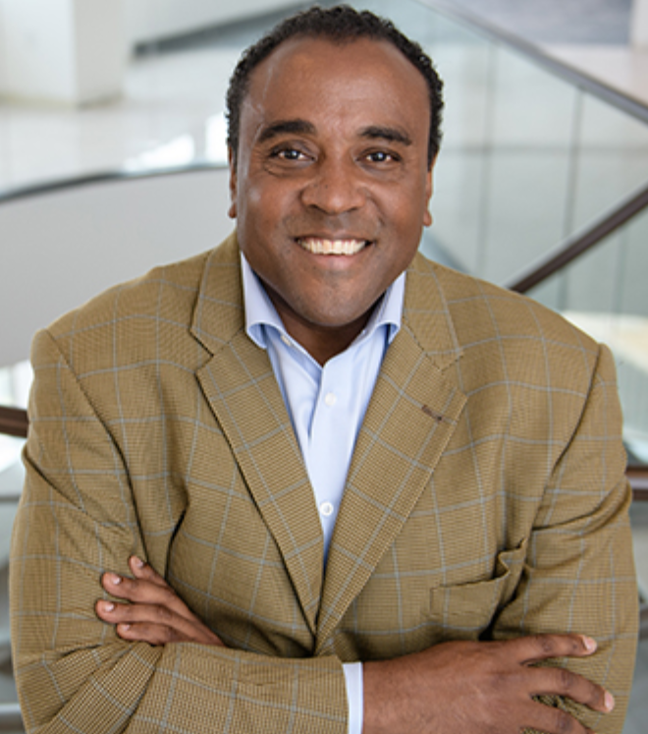
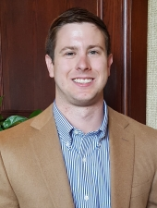
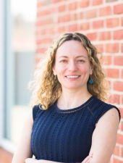

Project Team
Initiator
Gregory Fairchild
Associate Dean and Research Professor
Darden Graduate School of Business Administration
Lead
Nathaniel (“Nat”) Ratcliff
Research Assistant Professor
SDAD
Gizem Korkmaz
Research Associate Professor
SDAD
Aaron Schroeder
Research Associate Professor
SDAD
Along with Bayoán Santiago, Joel Thurston, and YOU

Slide 46
09-Returning Citizens Reentry Program
Project Background
Since the spring of 2011, UVA’s Darden Graduate School of Business Administration and Virginia’s Department of Corrections (VADOC) have partnered to provide entrepreneurship training at the Dillwyn and Fluvanna Correctional Centers
As a component of VADOC’s Resilience Education Programing, the Entrepreneurial Re-Entry Program addresses learning related to financial capability, personal finance, entrepreneurship, and foundations in business all taught by MBA students within Darden
The goal of the program is to provide offenders with the personal and professional skills that promote financial stability and self-employment prior to release so that these individuals can have increased employment opportunities and options once they re-enter society as citizens
Because the program is still in its early stages, there is little research evaluating its impact on prisoners once released (e.g., employment, recidivism)

Slide 47
Now tell us which projects you’d like to work on this summer!
Read the ‘Project Descriptions’ in the One Drive Shared Folder (will be shared this PM)
Talk to project leads & team members for more information
Send an email to Gizem Korkmaz (gkorkmaz@virginia.edu) & Aaron Schroeder (aschroed@virginia.edu) indicating:
- top 3 project choices
- level of R (and other language) skills (none/low/medium/high)
by 9AM tomorrow, sooner the better!
Talk to Gizem & Aaron for suggestions, next door
You will be assigned projects and mentors!

Slide 48
Now tell us which projects you’d like to work on this summer!
Project​ | a.k.a​ | Sponsor/Contact(s)​ | Lead​ | SDAD Team​ | Size
01. Credential-to-Skilled Technical Workforce (STW) Pathways in Virginia​ | Skilled Technical Workforce (STW)​ | John Finamore, National Center for Science and Engineering Statistics (NCSES)​ | Vicki​ | ​ | 1 fellow ​ 2 interns​
02. Machine Learning Techniques to Measure Business Innovation ​ | Business Innovation​ | Gary Anderson, NCSES​ | Devika​ | Gizem​ Neil | 1 fellow ​ 1 intern​
03. Defining and Measuring the Universe of Open Source Software​ Innovation​ | OSS​ | Carol Robbins, NCSES​ | Gizem​ | Bayoán​ | 1 fellow ​ 2 interns​
04. Measuring the Public Funding of R&D Projects​ | R&D Metrics​ | John Jankowski, NCSES​ | Stephanie​ | ​ | 1 fellow ​ 1 intern​
05. Discovering the Potential and Use of New Data Sources to Measure the Soldier’s Social Determinants of Health​ | ARI​ | Army Research Institute (ARI)​ | Stephanie​ | Josh​ | 1 fellow ​ 2 interns​
06. Validation of Broadband Data and Identification of Factors that Predict Property Values ​ | USDA Broadband​ | John Pender, USDA Economic Research Service (ERS)​ | Josh​ | Teja​ Stephanie​ | 1 fellow ​ 2 interns​
07. Economic and Social Impact of Arlington Restaurant Initiative​ | ACPD​ | Jim Mastoras​ Arlington County Police Department (ACPD)​ | Bayoán​ | Gizem​ Aaron​ | 1 fellow ​ 1 intern​
08. Building a Fairfax County CommunityScape to Understand Social Determinants of Health and Prosperity​ | Fairfax & INOVA​ | Fairfax County Health and Human Services,​ & Inova Translational Medicine Institute​ ​ | Teja​ | Joy​ Stephanie​ Vicki​ Josh​ Nathaniel​ Devika​ | 2 fellows​ 2 interns​
09. Returning Citizens Reentry Program​ ​ | Criminal Justice​ | Gregory Fairchild, Darden; UVA​ & Virginia Department of Corrections (VADOC)​ | Nathaniel​ | Joel​ Bayoán​ Gizem​ Aaron​ | 1 fellow 1 intern​

